Slide 1
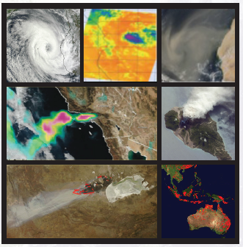
Discovering and Accessing Near real-time Data and Imagery through LANCE
Suomi NPP Applications Workshop
Tuesday 18th November 2014
Diane Davies
LANCE Operations Manager
diane.k.davies@nasa.gov

Slide 2
Land Atmosphere Near real-time Capability for EOS (LANCE) provides global Imagery and Data for near real-time Applications from AIRS, MLS, MODIS and OMI
Air Quality - Dust storms – Fires – Vegetation for agricultural monitoring – Floods – Ash Plumes – Drought – Smoke Plumes – Sea Ice for shipping – Severe Storms

Slide 3
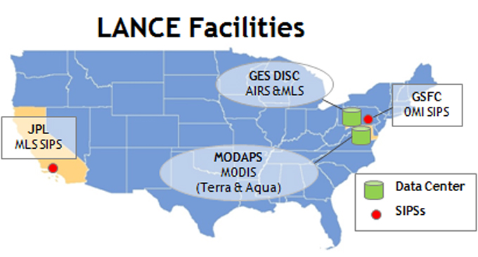
LANCE – A component of EOSDIS
LANCE is a component of EOSDIS – NASA’s Earth Observing System Data and Information System
NASA Earth Science Division sponsored the development of LANCE in 2009
LANCE is a virtual system that leverages existing EOSDIS components
LANCE provides a central point of access to high quality NRT data products for land and atmosphere studies within 3 hours of satellite observation
LANCE Web Site: http://earthdata.nasa.gov/lance

Slide 5
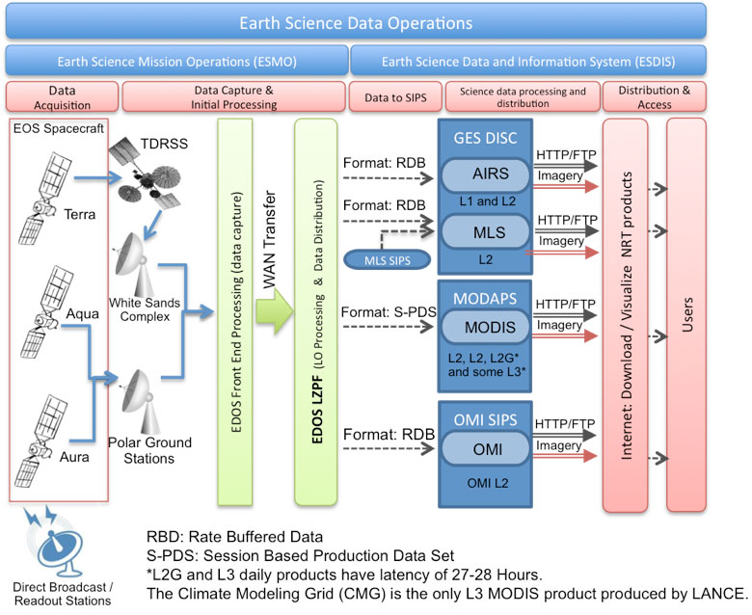
LANCE System Architecture

Slide 6
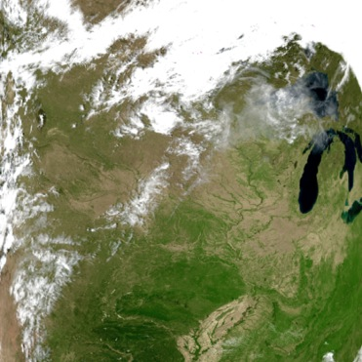
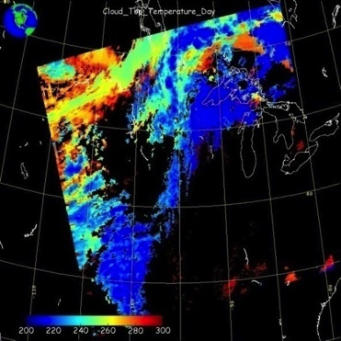
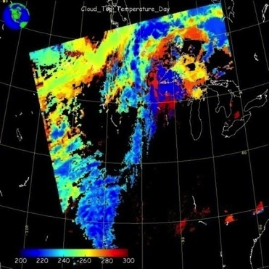
Comparison of NRT and Science Products
Latency requirements necessitate the use of predicted geo-location data and relaxed ancillary data – in some cases there are significant differences between the NRT and standard, science-quality data products, but overall the agreement is high. Expedited algorithms are overseen by science team members.
Science Product
Near Real-Time Product
Land Surface Reflectance
Cloud Top Temperature

Slide 7
LANCE NRT Products
Instrument (satellite) | Product Categories | Average Latency excluding Level 3
AIRS (Aqua) | Radiances, Temperature and Moisture Profiles, Precipitation, Dust, Clouds and Trace Gases | 75 – 140 minutes
MLS (Aura) | Ozone, Temperature, Carbon Monoxide, Water Vapor, Nitric Acid, Nitrous Oxide, Sulfur Dioxide | 75 – 140 minutes
MODIS (Aqua & Terra) | Radiances, Cloud/Aerosols, Water Vapor, Fire, Snow Cover, Sea Ice, Land Surface Reflectance, Land Surface Temperature | 60-125 minutes
OMI (Aura) | Ozone, Sulfur Dioxide, Aerosols, Cloud Top Pressure | 100 -165 minutes
AIRS - Atmospheric Infrared Sounder
MLS - Microwave Limb Sounder
MODIS - Moderate Resolution Imaging Spectroradiometer
OMI - Ozone Monitoring Instrument
AMSR2 – Advanced Microwave Scanning Radiometer 2 (GCOM-W1)
MISR - Multi-angle Imaging SpectroRadiometer
Notes:
LANCE distributes lower level products such as calibrated geo-located radiances and higher-level products such as active fire locations and snow cover.
Originally, LANCE provided data from Advanced Microwave Scanning Radiometer-EOS (AMSR-E), but in 2011, the AMSR-E instrument on the Aqua satellite malfunctioned and data provision was discontinued. LANCE is currently working to ingest and process ASMR2 data from the Japanese GCOM-W1 satellite. It is expected that the first NRT AMSR2 products will be made available in early 2015 subject to products being approved by the science team.
LANCE are also working with the MISR team to make MISR NRT L2 Winds products are available through LANCE.

Slide 8
Discover and Access LANCE products
LANCE Aims to provide data and imagery with high reliability using redundant systems
Data products (registration* required) from 2 strings:
Near Real-Time webpages: https://earthdata.nasa.gov/lance
FTP sites (HTTPS coming soon)
NASA Reverb: http://reverb.echo.nasa.gov/reverb/
Worldview (visual search) https://earthdata.nasa.gov/worldview
Imagery (no registration required)
Worldview
Global Imagery Browse Services
Rapid Response
FIRMS (Fire Information for Resource Management System)
MODIS Hotspot/Active Fire data sent via Email alerts, or available as vector/txt files
*EOSDIS User Registration System https://urs.earthdata.nasa.gov/users/new

Slide 9
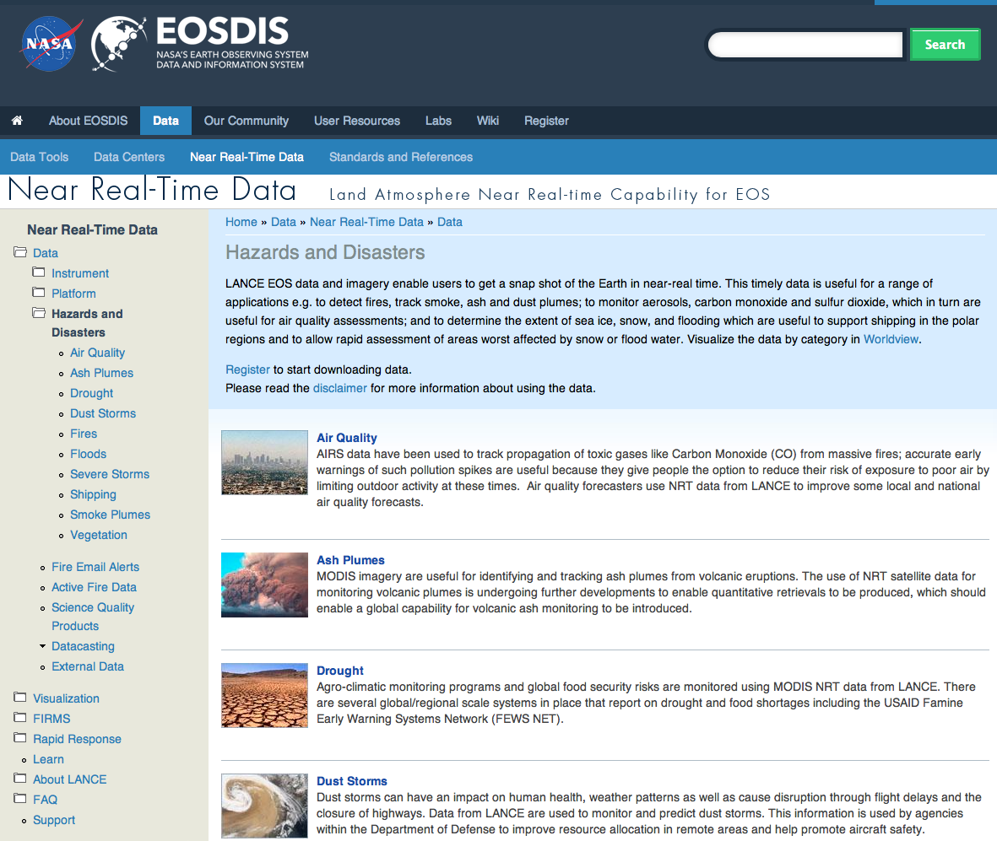
https://earthdata.nasa.gov/data/near-real-time-data/data/hazards-and-disasters
Notes:
For each Hazard or application area, LANCE provides a list of all potentially useful datasets, and where possible links to find out more about a particular event using a permalink that will take you to see imagery for the event in Worldview and where available a description of that event in NASA’s Earth Observatory.

Slide 10
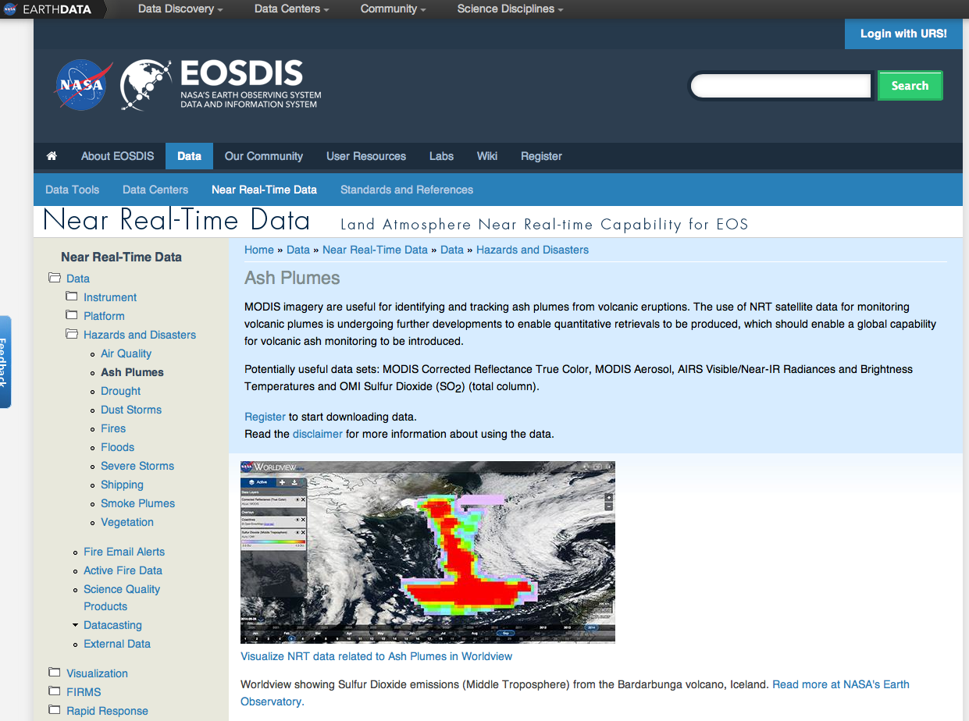
https://earthdata.nasa.gov/data/near-real-time-data/data/hazards-and-disasters

Slide 11
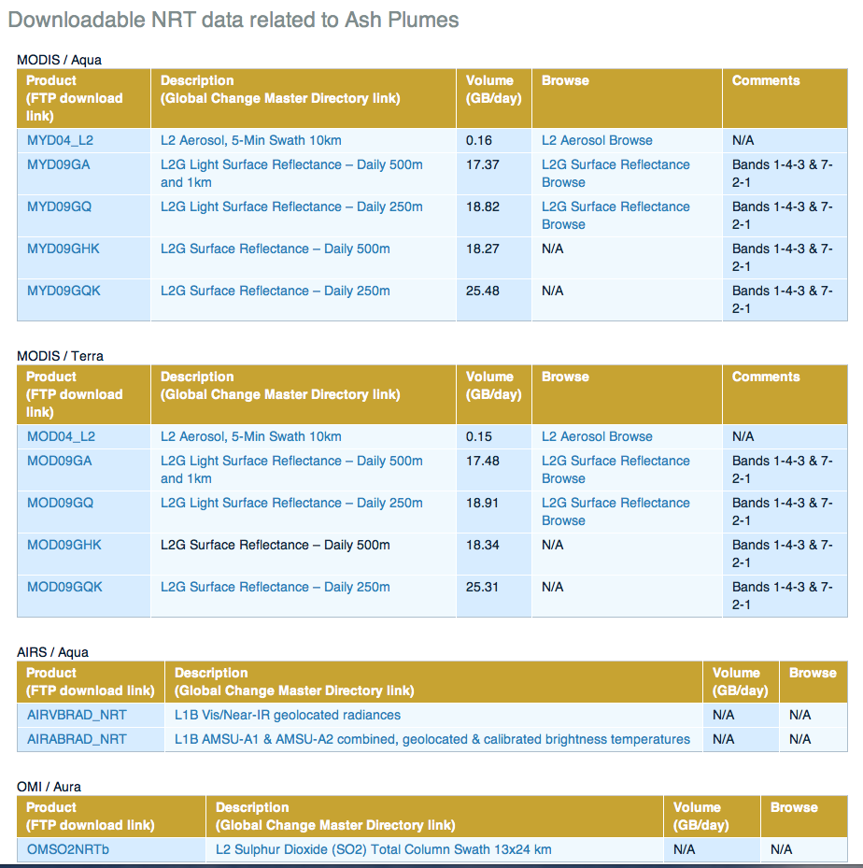

Slide 12
https://earthdata.nasa.gov/data/near-real-time-data/data/hazards-and-disasters
Notes:
Description with a permalink, to view the event in Worldview.

Slide 13
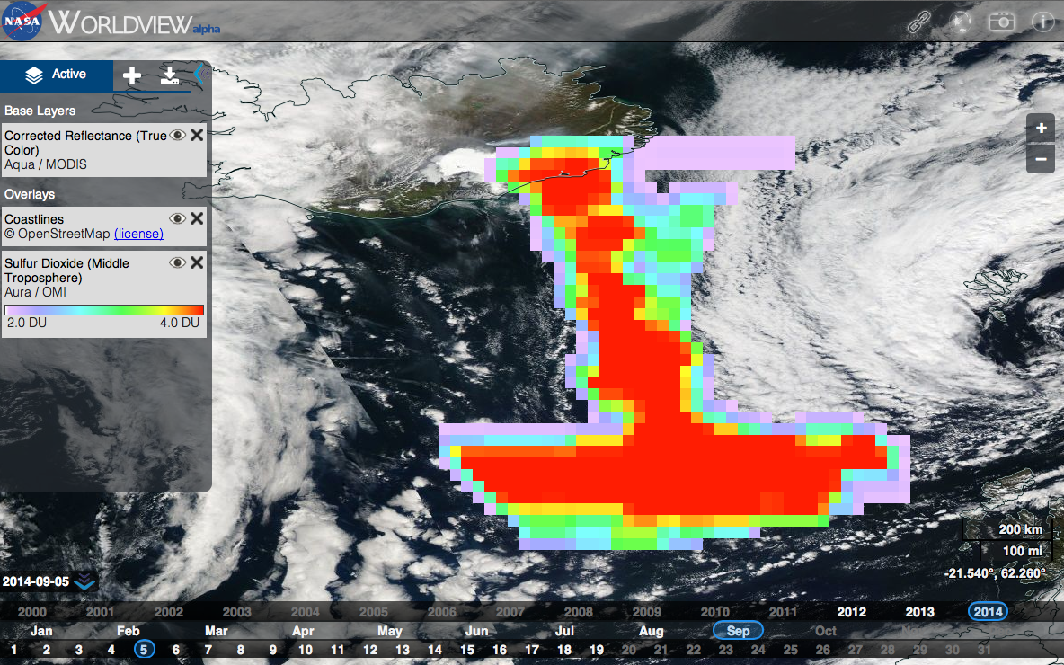

Slide 14
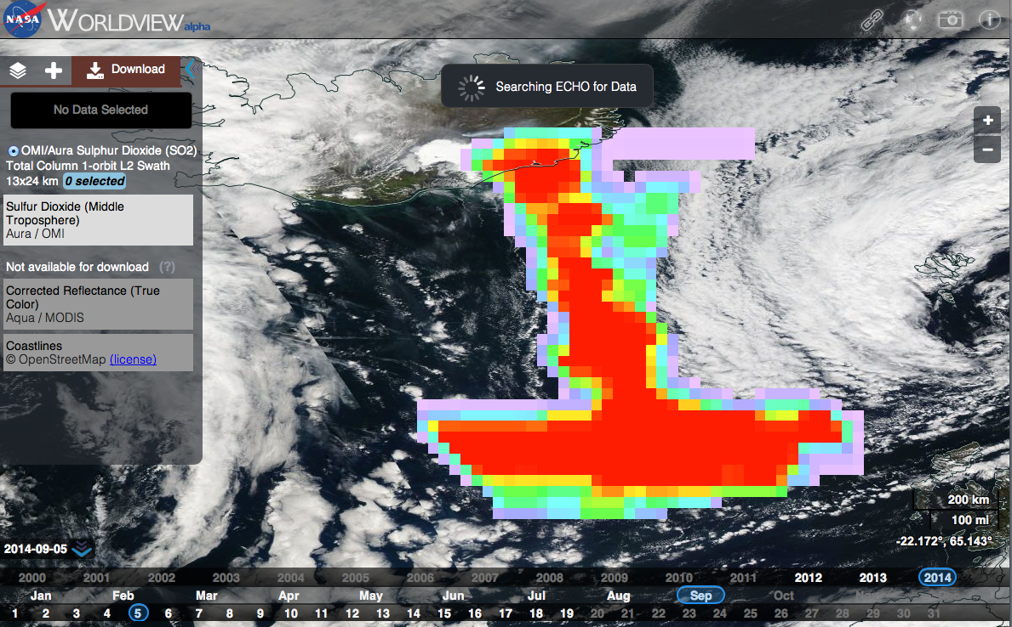

Slide 15
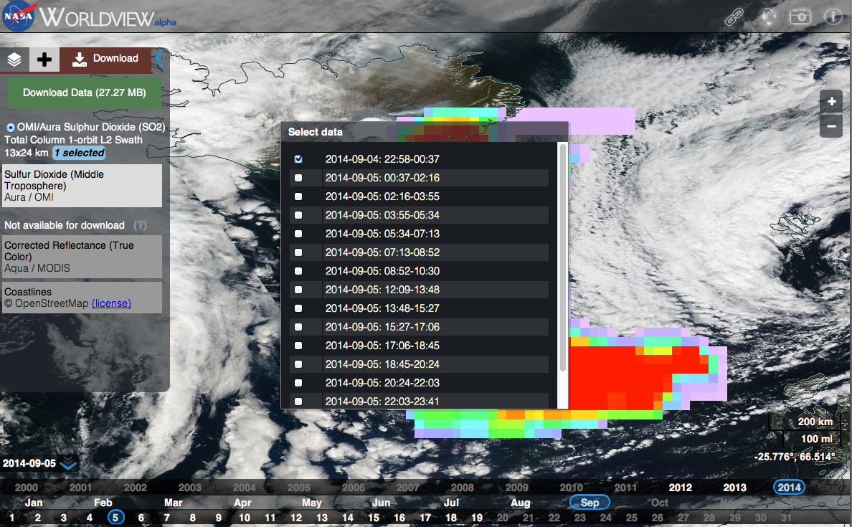

Slide 16
Discover and Access LANCE products
LANCE Aims to provide data and imagery with high reliability using redundant systems
Data products (registration* required) from 2 strings:
FTP sites (HTTPS coming soon)
NASA Reverb: http://reverb.echo.nasa.gov/reverb/
Near Real-Time webpages: https://earthdata.nasa.gov/lance
Worldview (visual search) https://earthdata.nasa.gov/worldview
Imagery (no registration required)
Worldview
Global Imagery Browse Services
Rapid Response
FIRMS (Fire Information for Resource Management System)
MODIS Hotspot/Active Fire data sent via Email alerts, or available as vector/txt files
*EOSDIS User Registration System https://urs.earthdata.nasa.gov/users/new

Slide 17
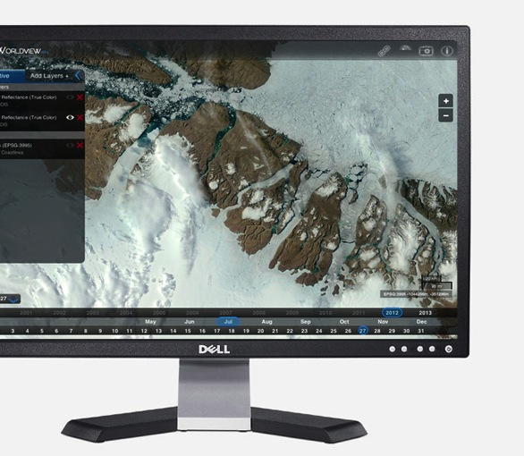
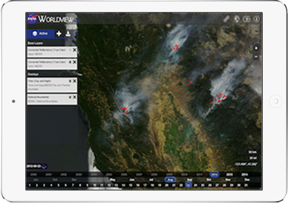
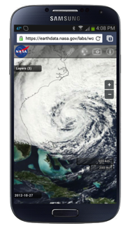
Worldview
EOSDIS Data Visualization, Discovery, and Download Tool for GIBS
Key Features:
75+ global satellite imagery products available from GIBS, many available within 4 hours of observation
Google Maps-like ability to interactively pan and zoom, then share “permalinks” with others
Unlike Google Maps, Worldview can
interactively change the currently-displayed time
view imagery in Arctic and Antarctic polar stereographic projections
download imagery in JPEG, PNG, GeoTIFF, and KML
download the underlying data used to generate the imagery
Web browser-based, developed using open standards (JavaScript, CSS, HTML) for cross-device compatibility; all code is available as open source
https://earthdata.nasa.gov/worldview
Slide courtesy of Ryan Boller and Matt Cechini

Slide 18
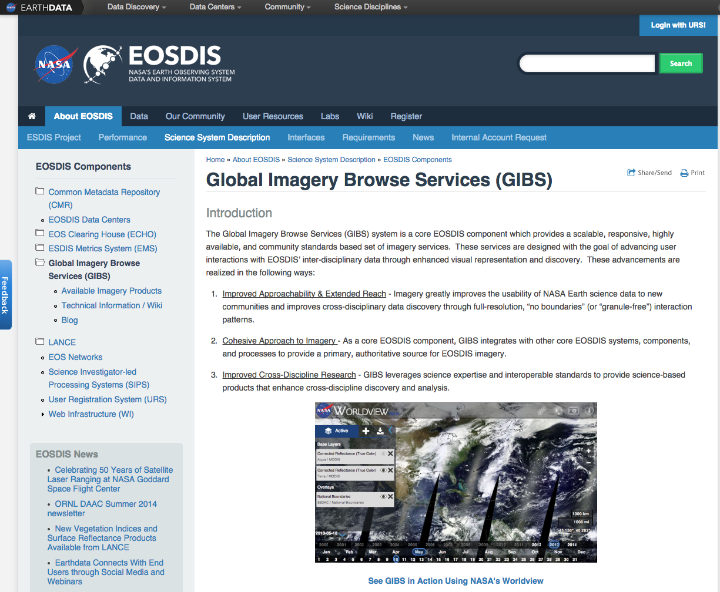

Slide 19
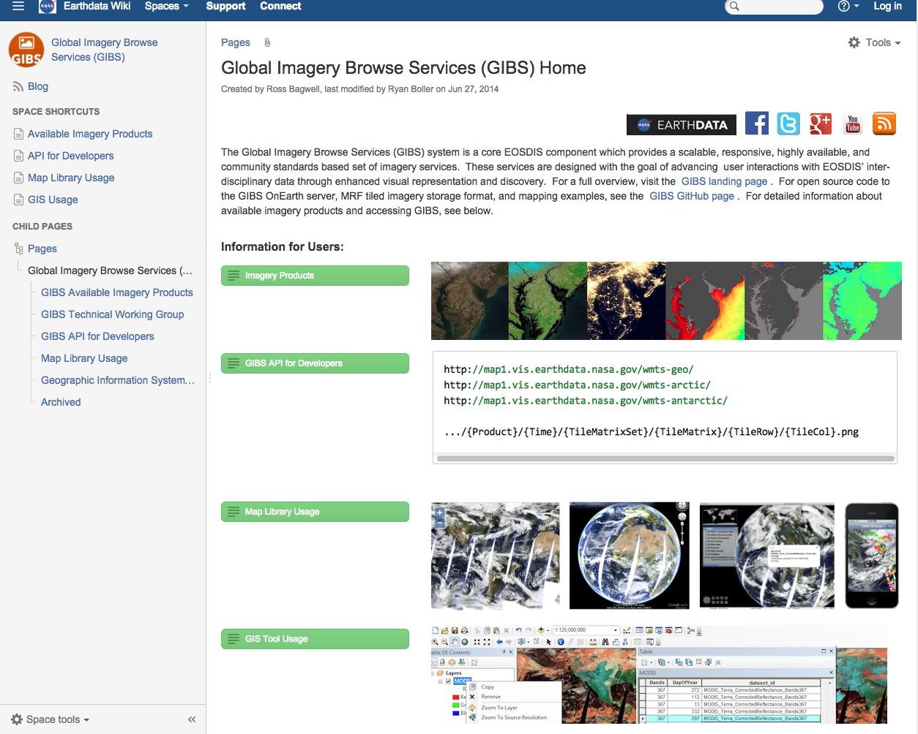

Slide 20
Discover and Access LANCE products
LANCE Aims to provide data and imagery with high reliability using redundant systems
Data products (registration* required) from 2 strings:
FTP sites (HTTPS coming soon)
NASA Reverb: http://reverb.echo.nasa.gov/reverb/
Near Real-Time webpages: https://earthdata.nasa.gov/lance
Worldview (visual search) https://earthdata.nasa.gov/worldview
Imagery (no registration required)
Worldview
Global Imagery Browse Services
Rapid Response
FIRMS (Fire Information for Resource Management System)
MODIS Hotspot/Active Fire data sent via Email alerts, or available as vector/txt files
*EOSDIS User Registration System https://urs.earthdata.nasa.gov/users/new

Slide 21
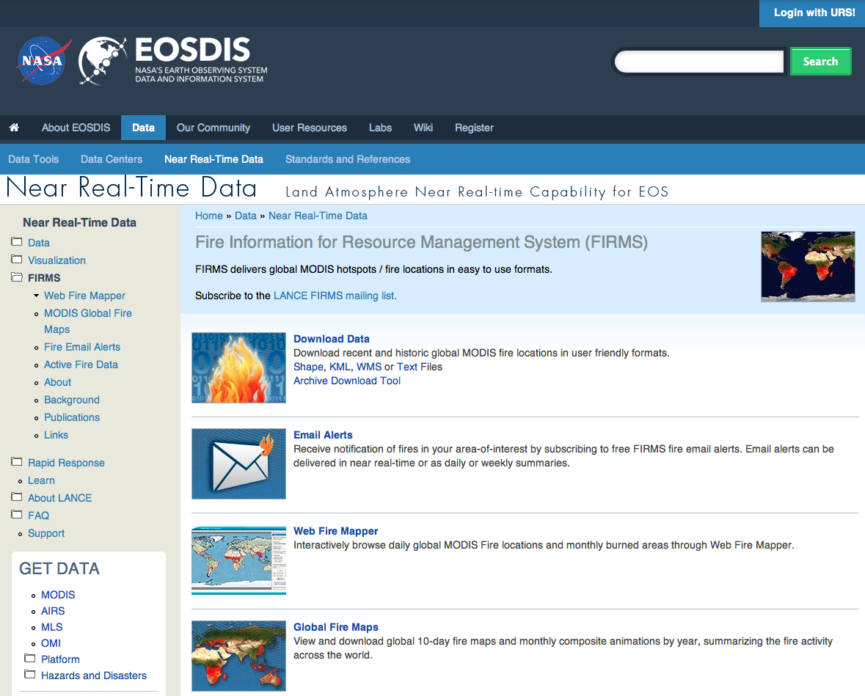

Slide 22
LANCE NRT Products are used in a range of applications

Slide 23
Example of LANCE data being used for Global Agricultural Monitoring:
GeoGLAM Crop Monitor

Slide 24
GEOGLAM Crop Monitor for AMIS (Agricultural Market Information System)
Endorsed by the G20 Heads of state
The objective of the Crop Monitor is to provide an international and transparent multi-source, consensus assessment of crop growing conditions, status, and agro-climatic conditions, likely to impact global production
inputs from GEOGLAM Community of Practice, international and national agencies, based on evidence from near real time satellite, weather, agromet, and national expert assessments
C. Justice and I. Becker-Reshef, GeoGLAM /UMD

Slide 25
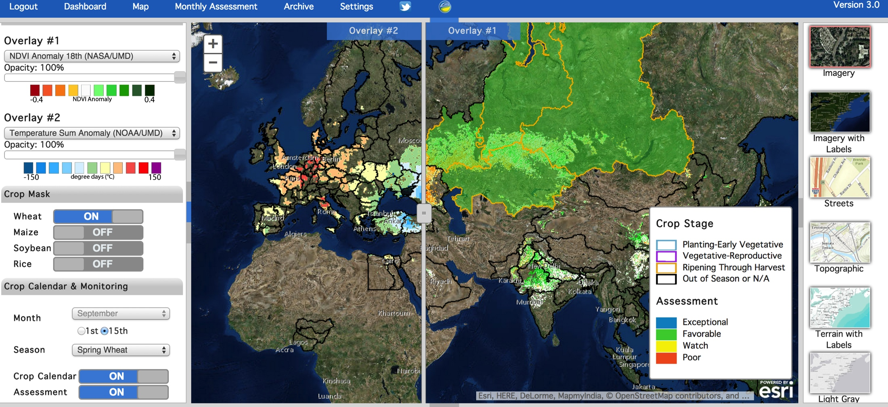
Crop Monitor Communication Interface for Crop Condition Assessments
Slides from C. Justice and I. Becker-Reshef, GeoGLAM /UMD
Notes:
The interface won the ESRI Special Award in GIS

Slide 26
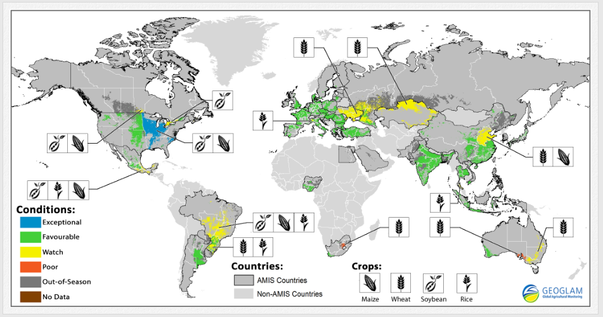
Current Crop Monitor Products for AMIS: Synthesis Condition Maps (other versions available online)
Crop Conditions as of October 28th, 2014
Crop condition map synthesizing information for all four AMIS crops
Crops that are in other than favorable conditions are displayed on the map with their crop symbol.
(Cropland area shown is an aggregation of all cropland areas)

Slide 27
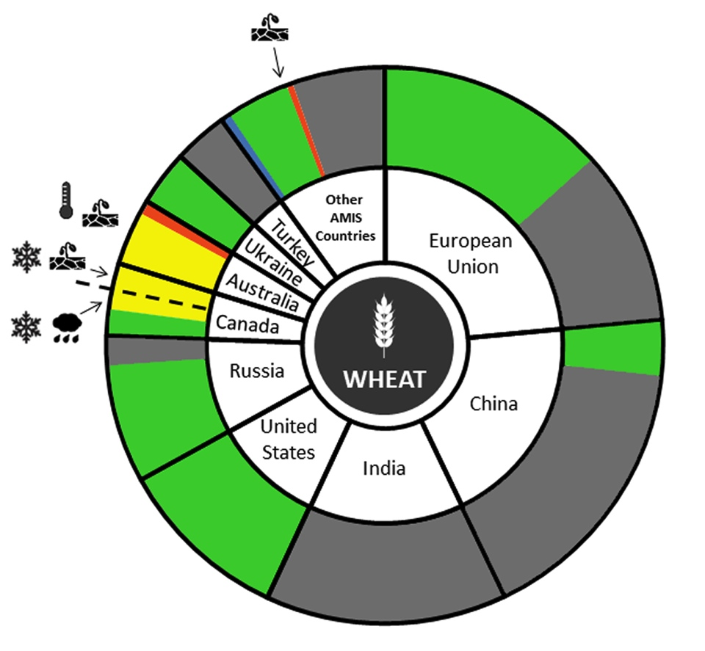
Pie Charts, with crop condition drivers
Crop Conditions as of September 28th, 2014
As share of:
Wheat Production
Wheat Exports (available online)
A country’s slice represents its portion of the 5 year average of the total AMIS countries production

Slide 28
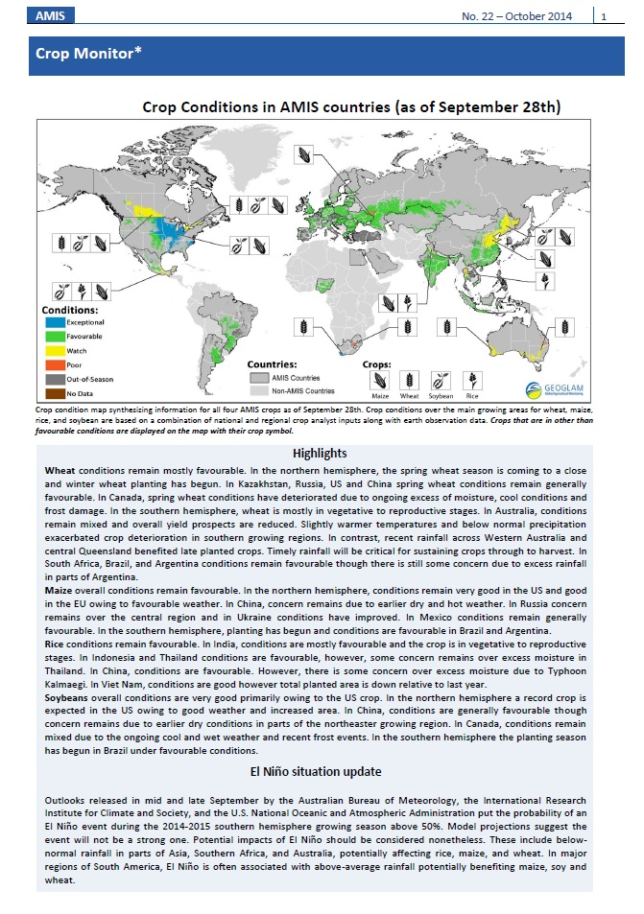
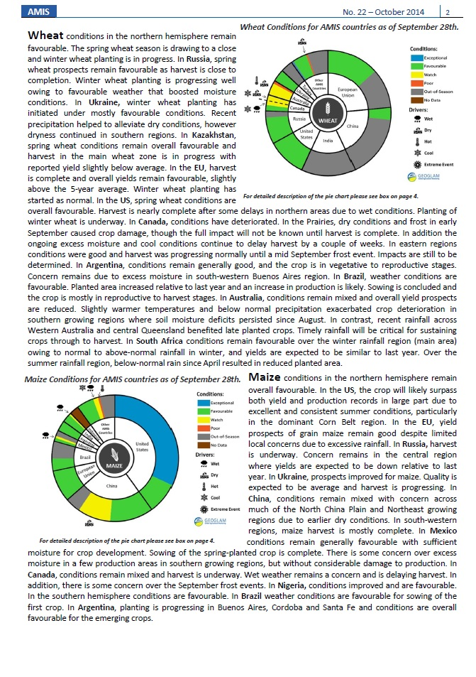
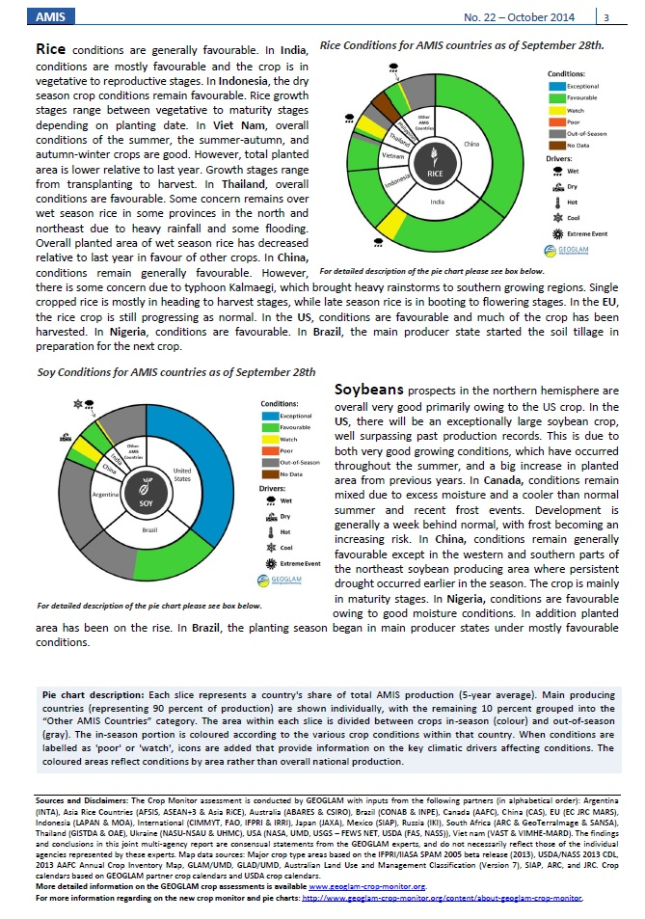
October 2014 Crop Monitor issue
http://geoglam-crop-monitor.org/

Slide 29
The LANCE UWG which provides a forum for NASA’s NRT data users has recommended VIIRS products be generated by the LANCE system.
29

Slide 30
Links and More Information
LANCE Near Real-Time webpages:
LANCE https://earthdata.nasa.gov/lance
Worldview https://earthdata.nasa.gov/worldview
Global Imagery Browse Services https://earthdata.nasa.gov/gibs
GIBS wiki: https://wiki.earthdata.nasa.gov/display/GIBS/
FIRMS: https://earthdata.nasa.gov/firms
NASA Reverb: http://reverb.echo.nasa.gov/reverb/ EOSDIS User Registration System: https://urs.earthdata.nasa.gov/users/new
Questions?
support@earthdata.nasa.gov
diane.k.davies@nasa.gov

Slide 31
Key differences between NRT and Standard Processing
Process | Standard Products | Near Real-Time
Level 0 processing | Standard processing use definitive geo-location (attitude and ephemeris) data. | Predicted geo-location. Terra via an on-board GPS. Aqua and Aura use spacecraft housekeeping data and predicted geo-location.
Level 2 products that do not make use of ancillary data e.g. fire, snow, sea ice | Standard processing code | Inherent differences from L0 plus standard processing codes.
Level 2 products that require ancillary data | Standard requirements | Inherent differences from L0 and relaxed requirements for ancillary data

